Slide 1

Car Parking Management System
by Alabama Technologies

Slide 2
CAR PARKING MANAGEMENT SYSTEM
INTRODUCTION:
This mini-program is a C# project for car parking management. This is a desktop based application developed for billing and maintaining and keeping record of vehicle flow in small parking lots. This project utilizes data to/from the public list as it’s back-end.
OBJECTIVE:
The objective of this car parking management system is to manage the details of vehicles, parking fees, and parking slots.

Slide 3
FEATURES
It increases the efficiency of managing the vehicles and parking fees.
It generates the report on vehicles, parking fees, and duration.
It gives the user the option to view and delete the created reports in the program.
It provides a fair bill for parking according to time duration.
It displays the vacant and occupied parking slots.
It guides the customer to the vacant parking slot.

Slide 4
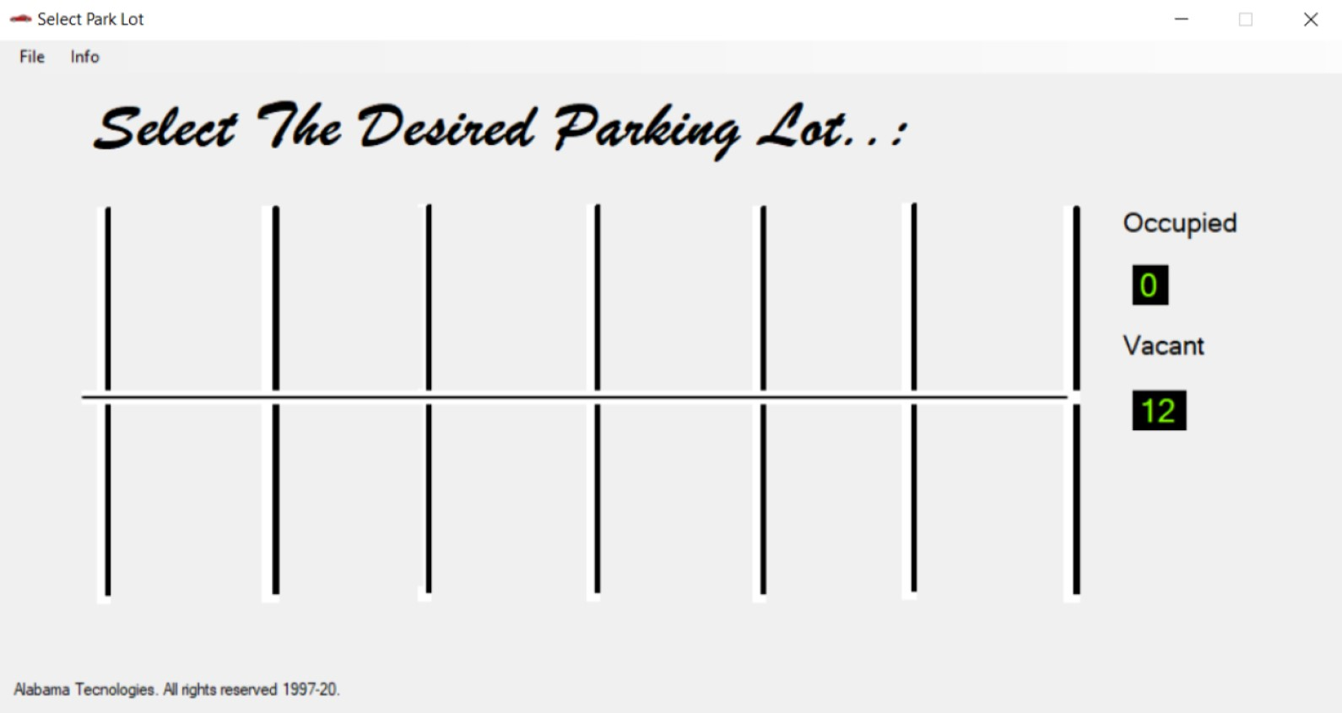
Working
When the program starts, it displays a map of the parking slots.

Slide 5
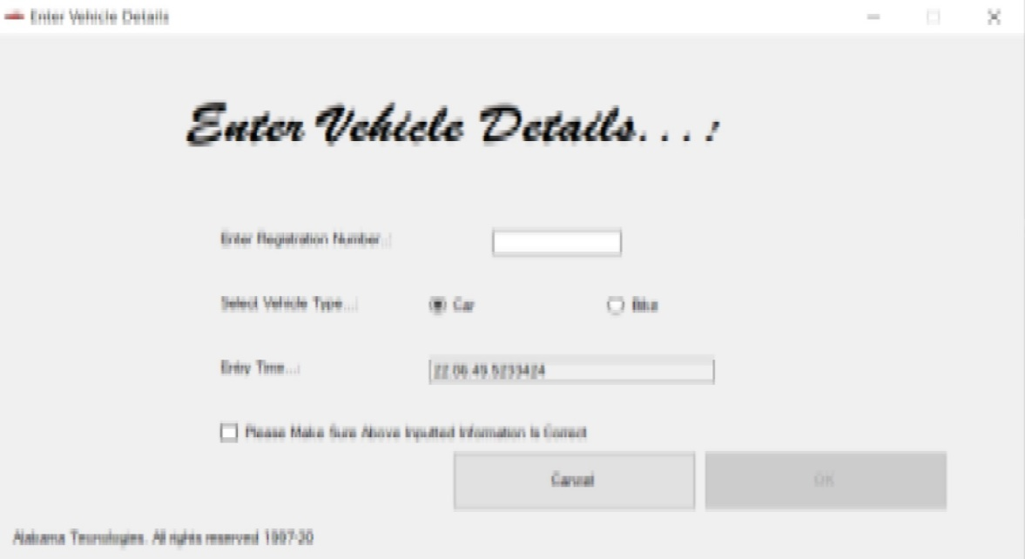
working
When any one of the vacant parking slots is selected, the data entry form pops up.
The customer is then required to type in the vehicle’s registration number and the type of vehicle, which the customer owns.
The algorithm is designed to take in the entry time automatically from the system, to maintain efficiency.

Slide 6
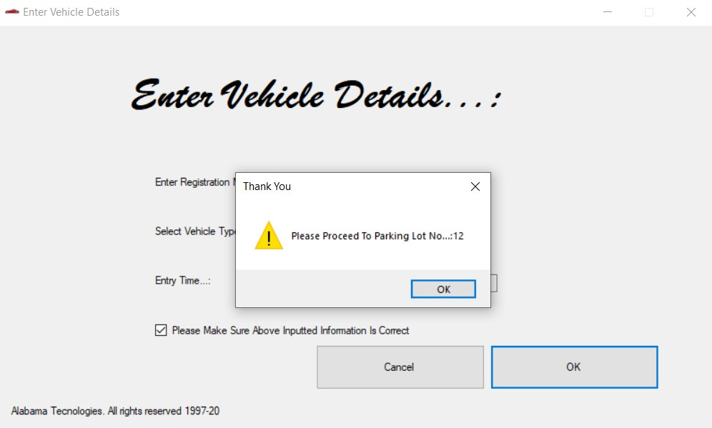
working
After filling the form, the customer proceeds to the parking slot designated to the customer.

Slide 7
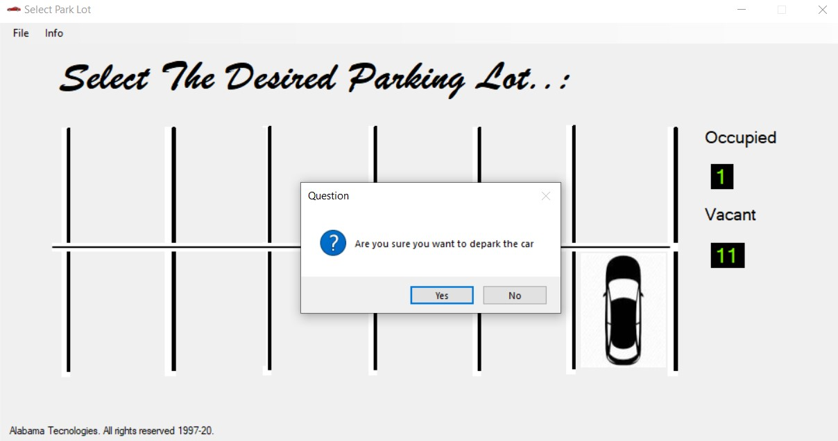
working
To show the exit procedure, we click on the parking slot, which displays the registration number of the customer’s vehicle.
When the above procedure is implemented, a message box pops up which asks for confirmation.

Slide 8
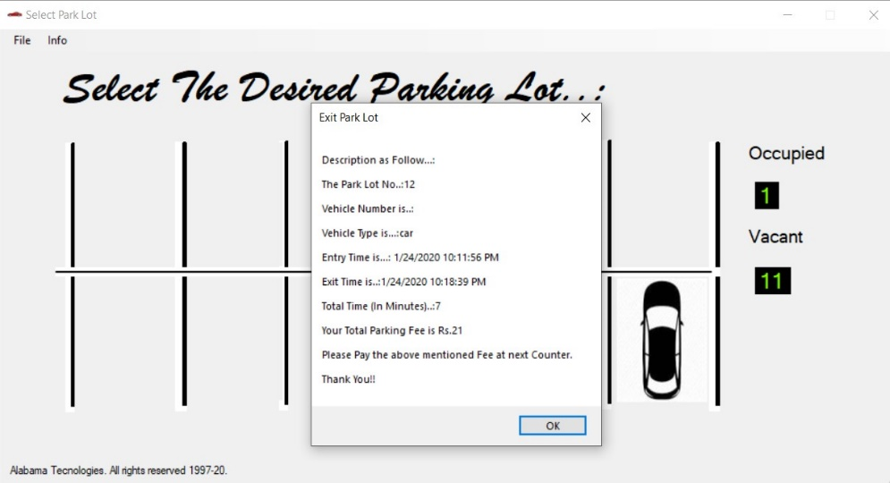
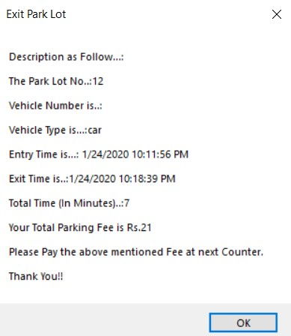
working
As soon as the action is confirmed, a window pops up which displays all the details, such as; the vehicle’s registration number, slot number, entry time, duration, and exit time.
Taking these details into record, the system generates a bill which is to be paid by the customer at the next counter.

Slide 9
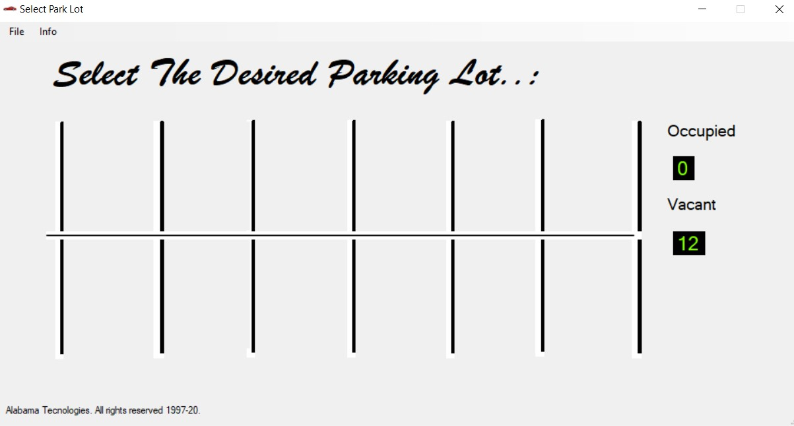
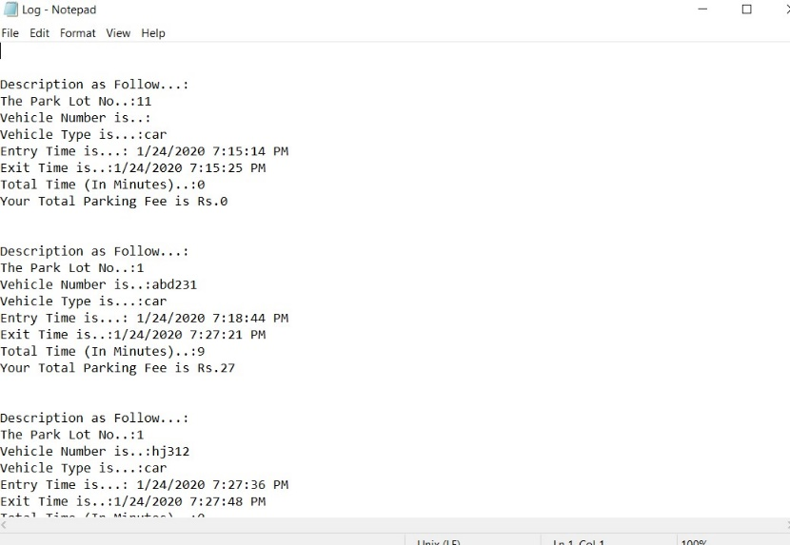
working
As soon as the vehicle leaves the parking slot, the system displays that parking slot as vacant, and the vehicle’s details are noted in the log file for record keeping.

Slide 10
The end

